Slide 1


BIG DATA ANALYTICS IN HEALTHCARE
Presented by : Mohaiminul Islam
Chongqing University of Science and Technology

Slide 2
Overview
Big Data
Importance of Big Data Analyics in Healthcare
Big Data Analytics Advantages in Helthcare System
Big Data Application in Healthcare
Big Data Examples in Healthcare
Challenges of Big Data Analytics in Healthcare
Conclusion

Slide 3
Big Data
Big data refers to data that is so large, fast or complex
Concept of big data gained momentum in the early 2000s
Big Data use for cost reductions, time reductions,new product development, smart decision making

Slide 4
Importance of Big Data Analytics in Healthcare
Build sustainable healthcare systems
Collaborate to improve care and outcomes
Increase access to healthcare

Slide 5
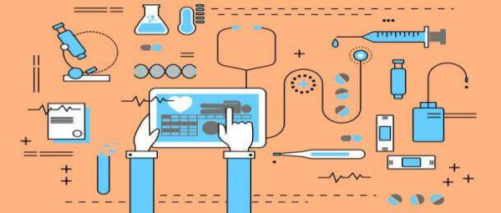
Big Data Analytics Advantages in Healthcare System
Higher-Quality Care
Reduce the treatment price
Predict the potential diseases
Prevent serious diseases
Fig. Data Analytics in Healthcare

Slide 6

Big Data Applications in Healthcare
Patients Predictions
Electronic Health Records
Real-Time Alerting
Reduce Fraud and Enhance Security
Telemedicine
Integrating Big Data With Medical Imaging
Predictive Analytics In Healthcare
Fig. Patients Prediction

Slide 7
Big Data Examples in Healthcare
Predict the daily patients income to tailor staffing accordingly
Use Electronic Health Records (EHRs)
Use real-time alerting for instant care
Enhance patient engagement in their own health
Use health data for a better-informed strategic planning
Research more extensively to cure cancer
Use predictive analytics
Reduce fraud and enhance data security
Practice telemedicine
Integrate medical imaging for an broader diagnosis
Prevent unnecessary ER visits

Slide 8
Challenges of Big Data Analytics in Healthcare
Capture
Cleaning
Storage
Security

Slide 9
Concusion
Healthcare analytics have the potential to reduce costs of treatment, predict outbreaks of epidemics, avoid preventable diseases and improve the quality of life in general. Average human lifespan is increasing along world population, which poses new challenges to today’s treatment delivery methods. In the future we’ll see the rapid, widespread implementation and use of big data analytics across the healthcare organization and the healthcare industry. To that end, the several challenges highlighted above, must be addressed. Big data analytics and applications in healthcare are at a nascent stage of development, but rapid advances in platforms and tools can accelerate their maturing process.

